Slide 1
Jean Nouvel seating collection
The Modern Nature of Seating.
FOR INTERNAL USE ONLY

Slide 2
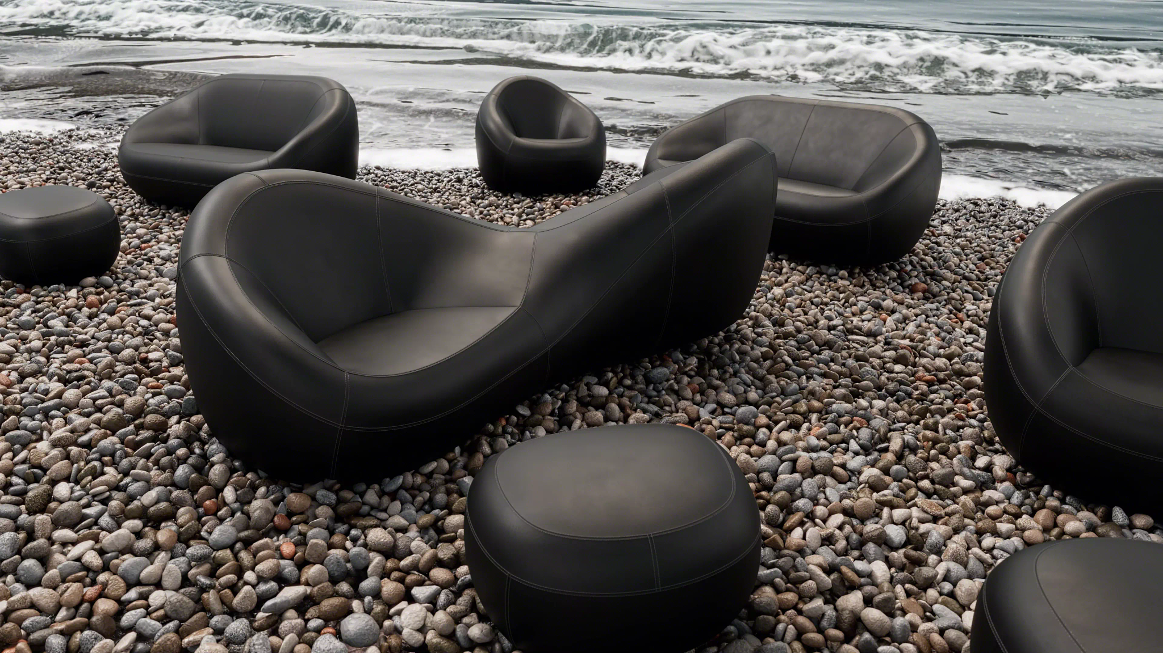
Free Your Form.
Introducing the modern nature of seating. From architect Jean Nouvel and
the Coalesse Design Group, elemental forms reminiscent of pebbles combine freely to take any shape in a space — furniture that flows naturally.

Slide 3
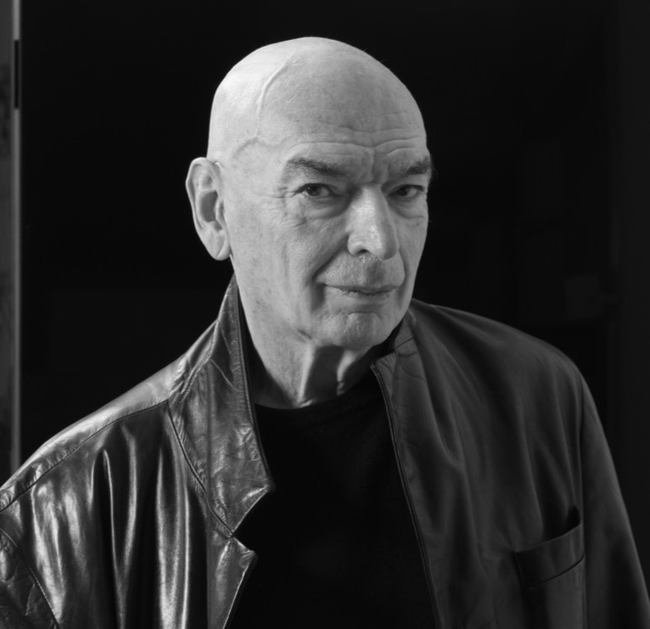
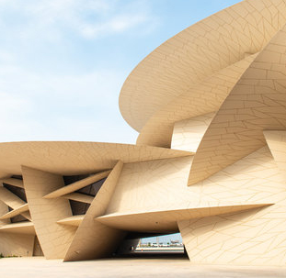
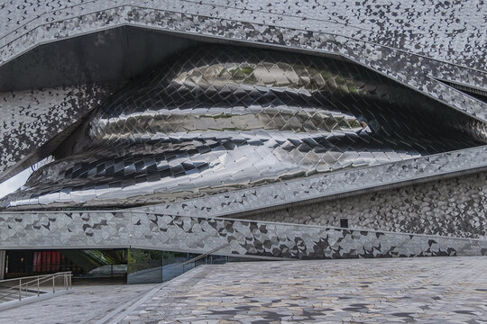
Coalescing with Jean Nouvel
Pritzker Prize-winning architect Jean Nouvel creates buildings and furnishings that are intimately in harmony with their surroundings — modern expressions of nature and culture. Nouvel brings his iconic sensibility and a sense of seating history to his collaboration with the Coalesse Design Group, producing a collection of seemingly freeform lounges and sofas that give shape to any type of work, civic, social or residential setting.

Slide 4
“The simpler an object looks, the more obvious or familiar, the harder it is to make, the more emotion it offers, and the better it stands the test of time.”
- Jean Nouvel

Slide 5
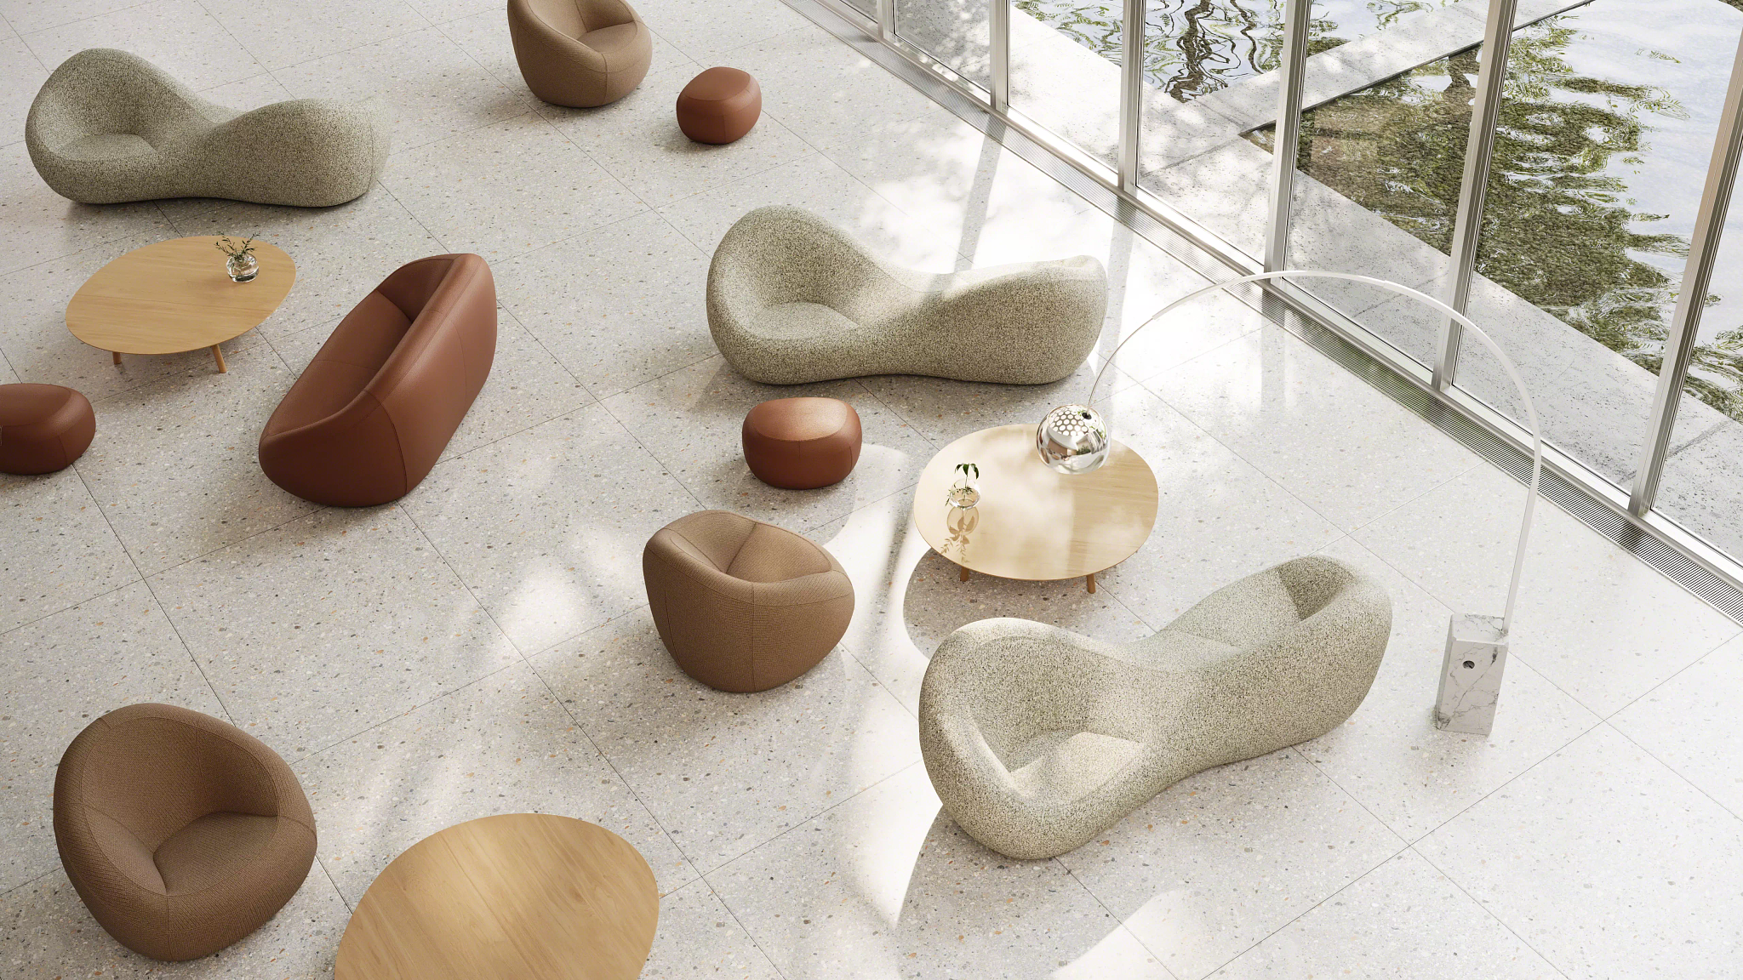
Where form meets space
Echoing the spontaneity of natural formations in landscapes, water and sky, any grouping of furniture can be assembled to create organic clusters and currents — and never be the same twice.

Slide 6
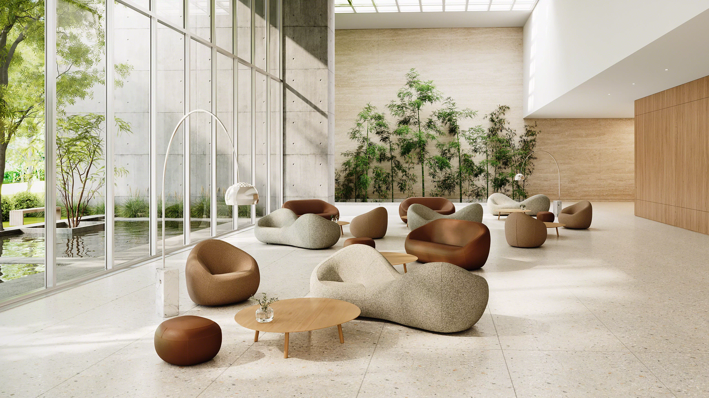

Slide 7
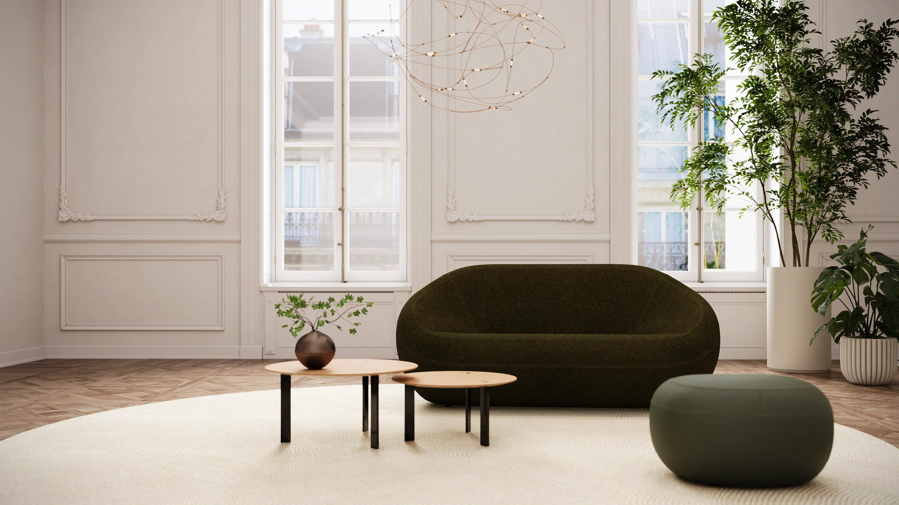

Slide 8
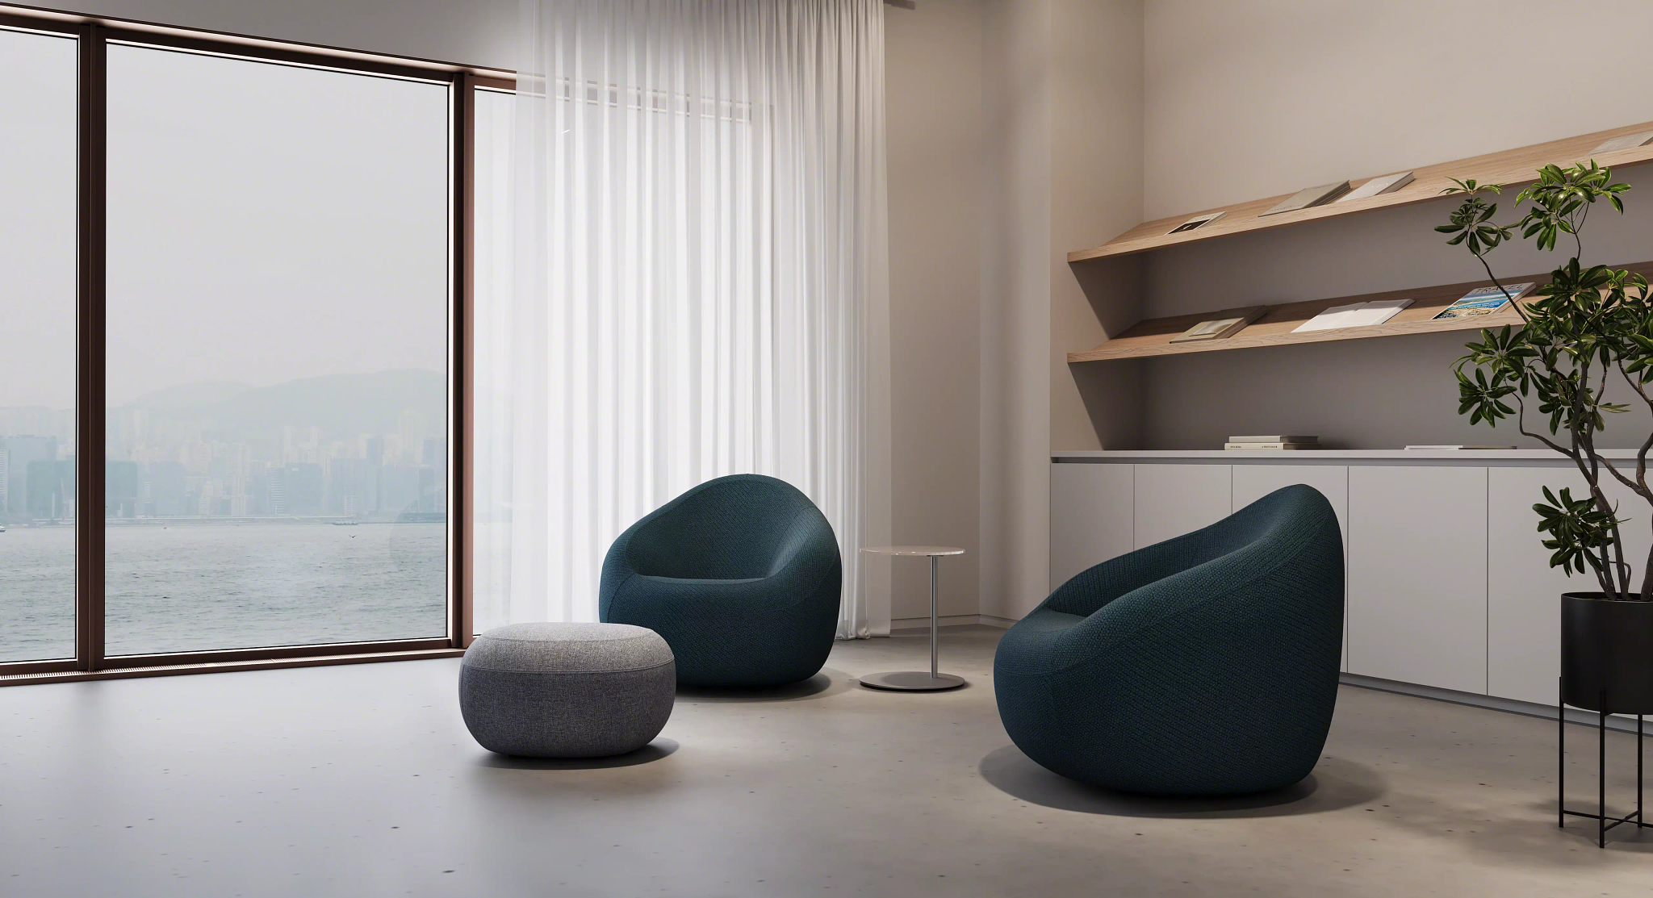

Slide 9
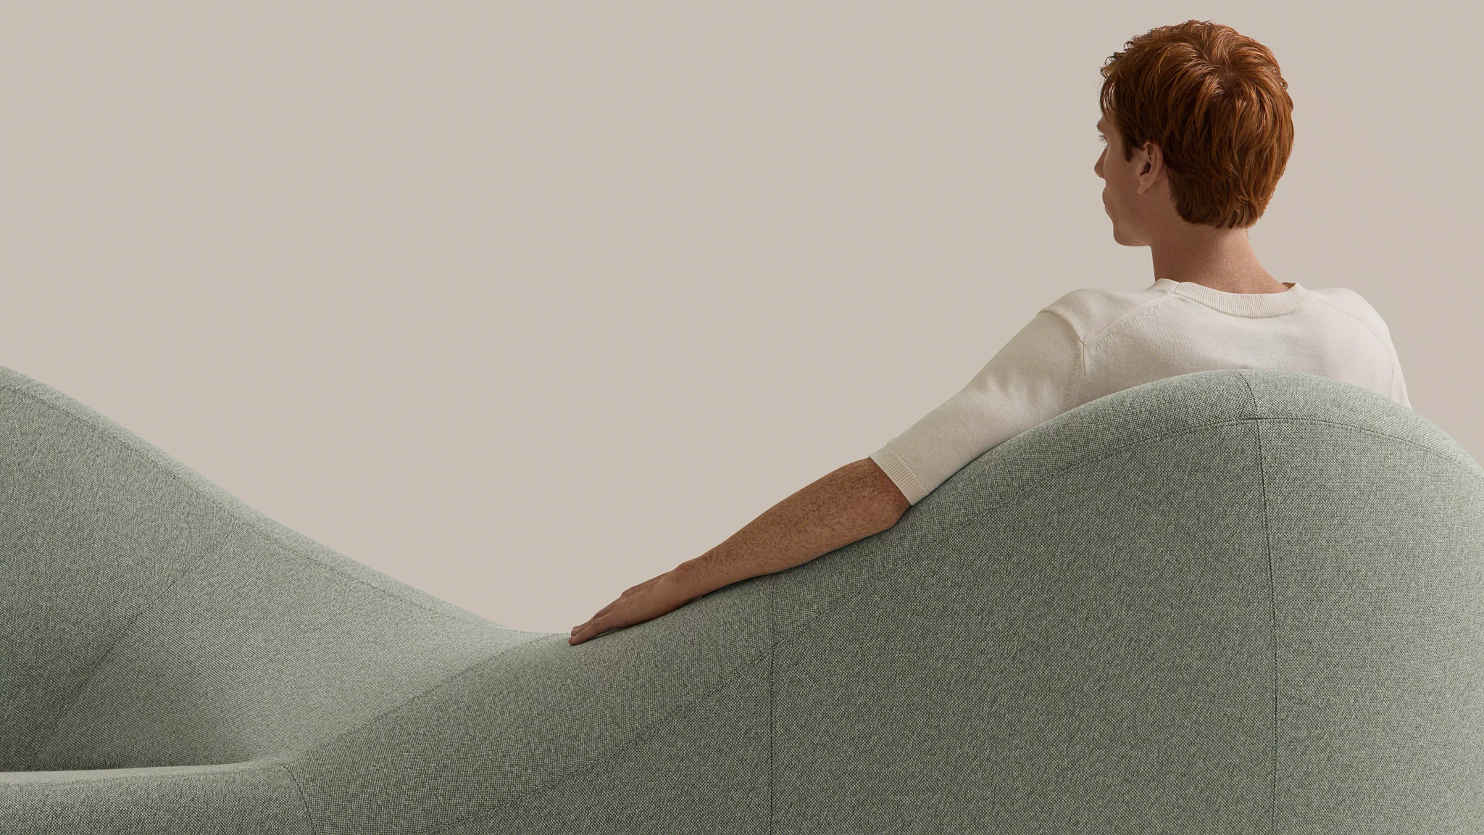
Where bold meets delicate
Modern curves. Maximum comfort. Built with subtle contours that expertly support arms and backs, boldly rounded forms flow like a wave across the seams and swells of each seat to suspend the body softly.

Slide 10
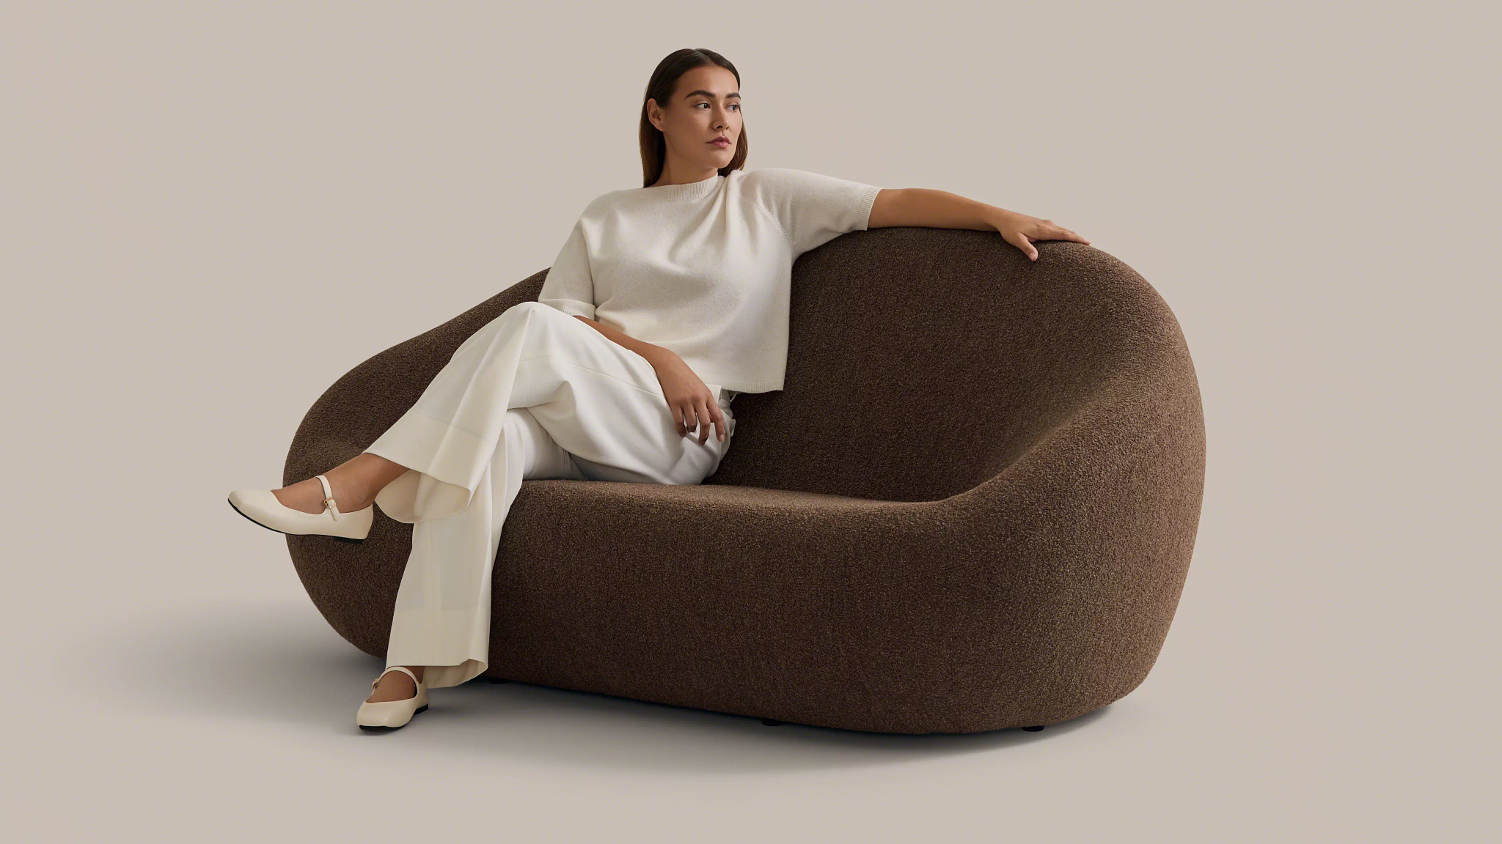

Slide 11
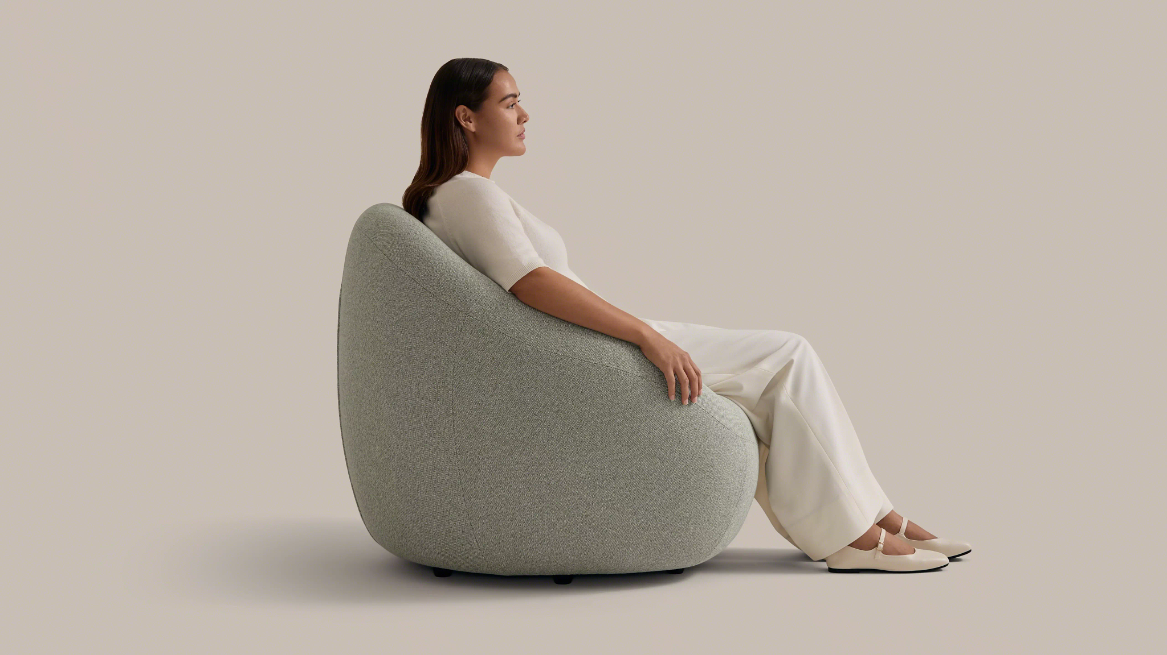

Slide 12
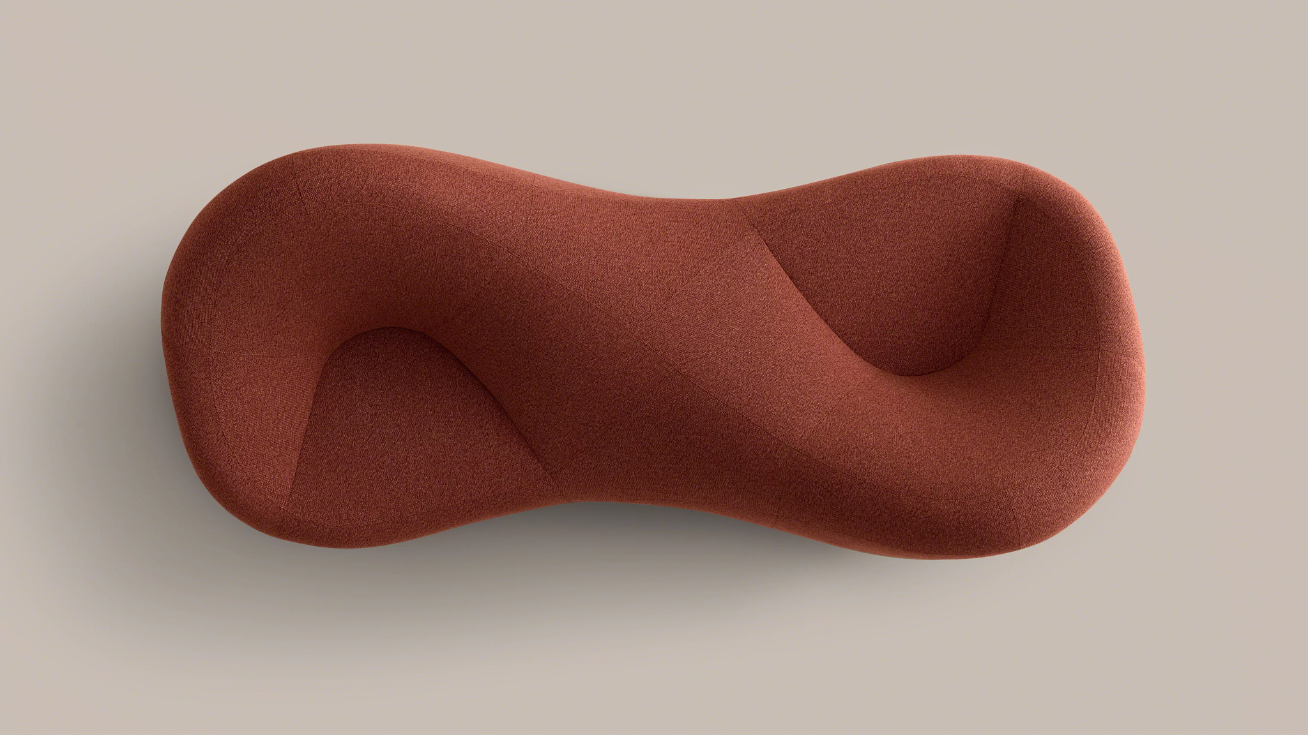
Where comfort meets company
Ateliers Jean Nouvel reimagines the classic French tête-à-tête loveseat in a sculptural update that intuitively brings people together.

Slide 13
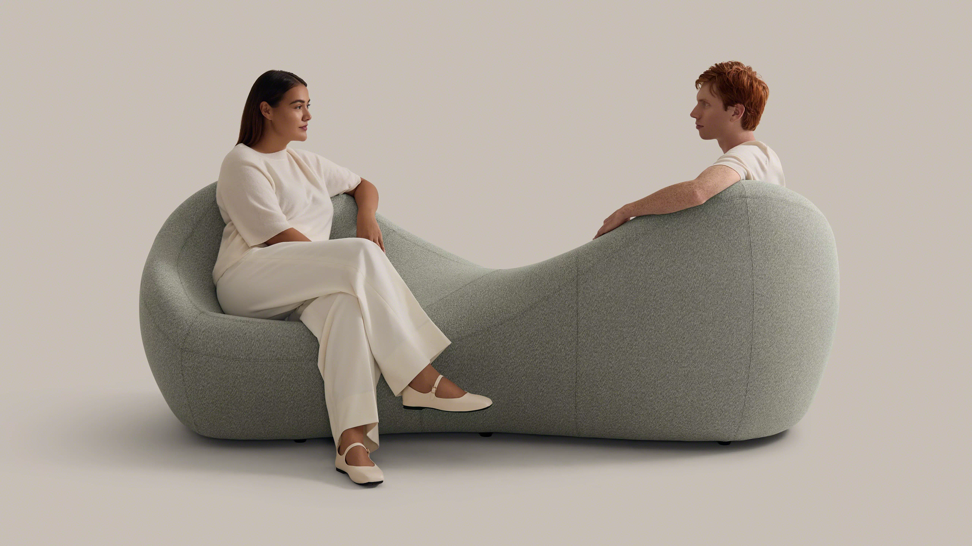

Slide 14
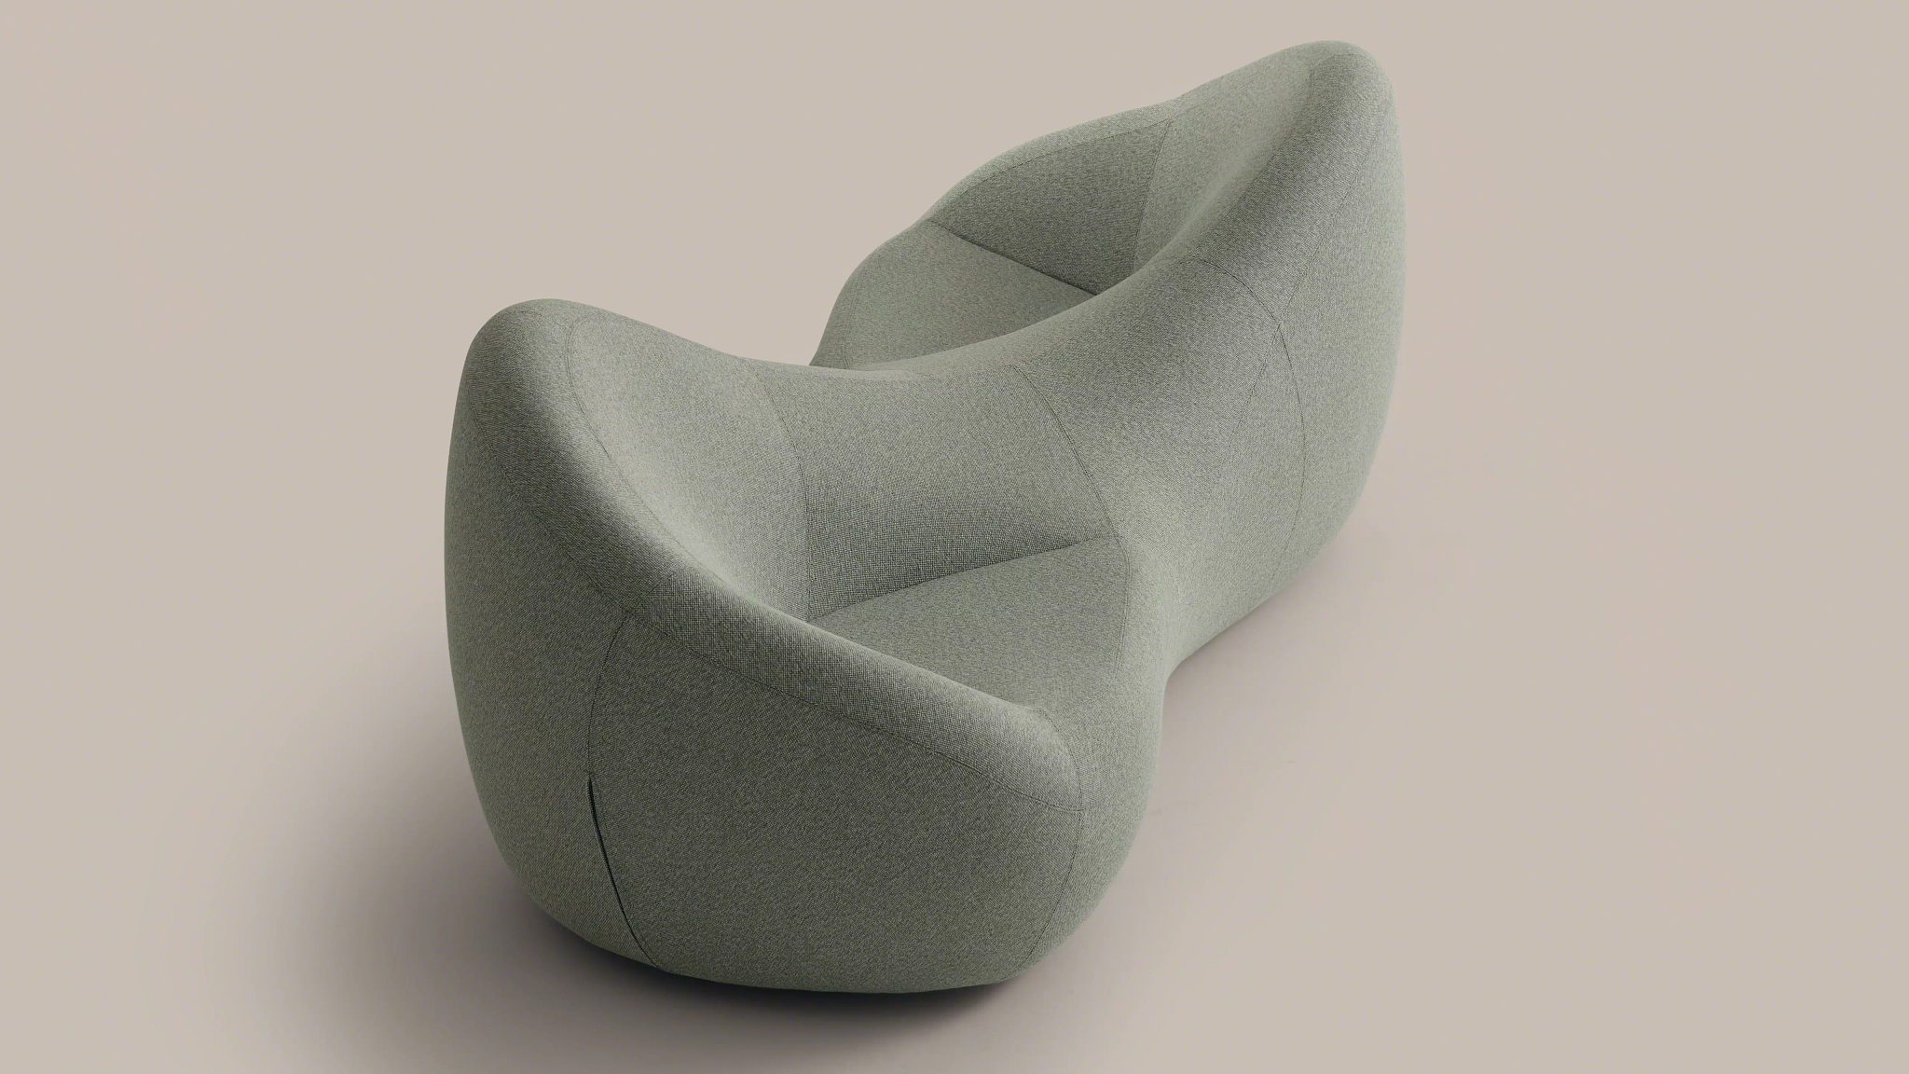

Slide 15
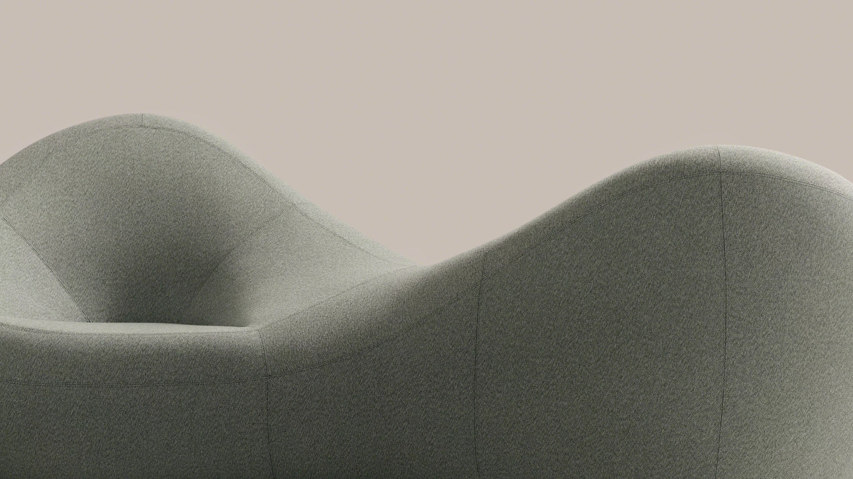

Slide 16
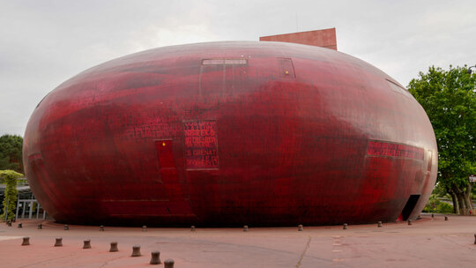
Where Jean Nouvel meets Coalesse
The Coalesse Design Group and Atelier Jean Nouvel worked together to develop the complex engineering and pattern work needed to make edgeless forms possible. Like rocks in a riverbed or shifting dunes – and like Nouvel’s own architecture – the pieces are full of continuous curves.

Slide 17
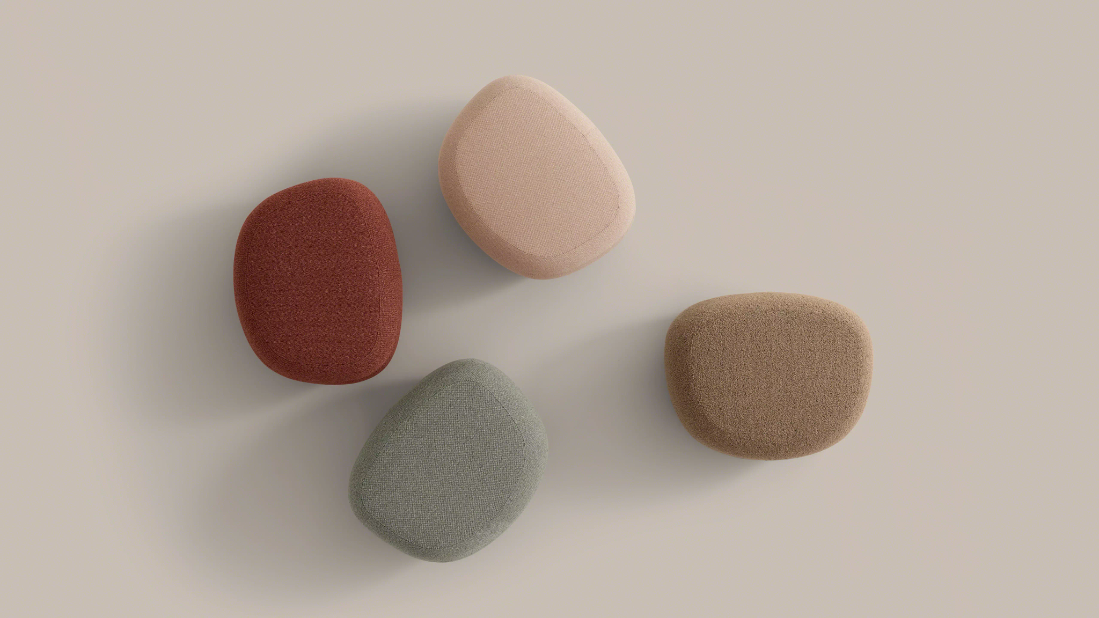

Slide 18
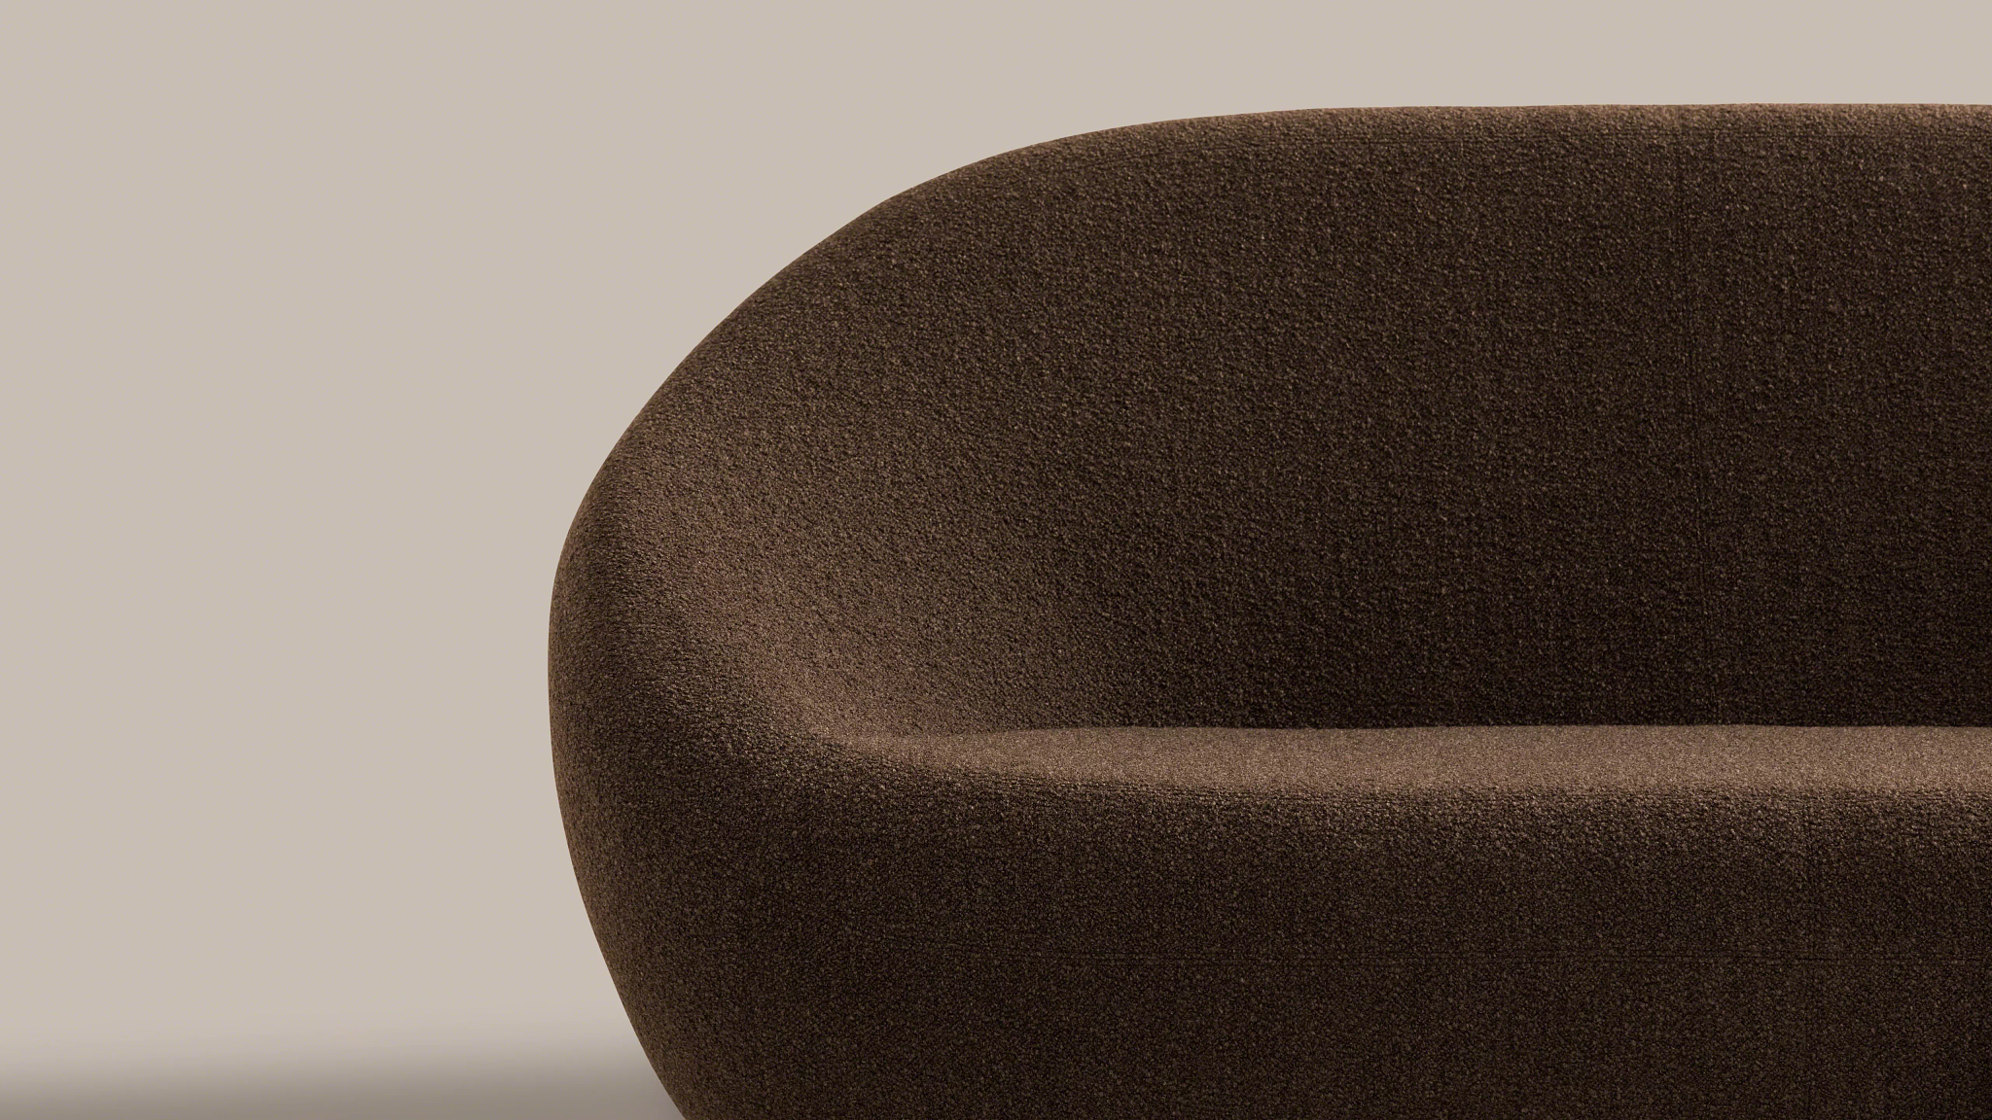

Slide 19
Product Information

Slide 20
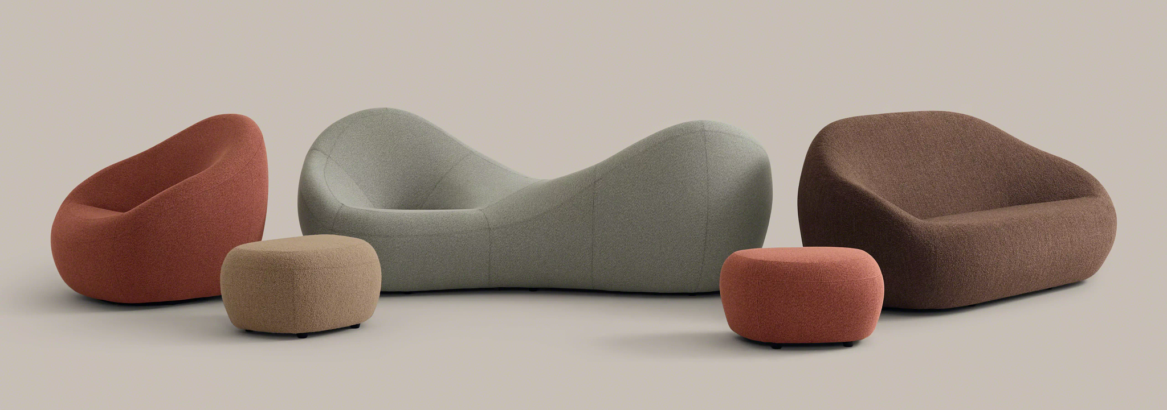
Designed as a single statement of line that can fill a whole space on its own. Choose a non-directional assemblage or a pristine pairing. Combine with other furniture. Change colors or textures. Like nature, no one formula applies.
Never the same twice.

Slide 21
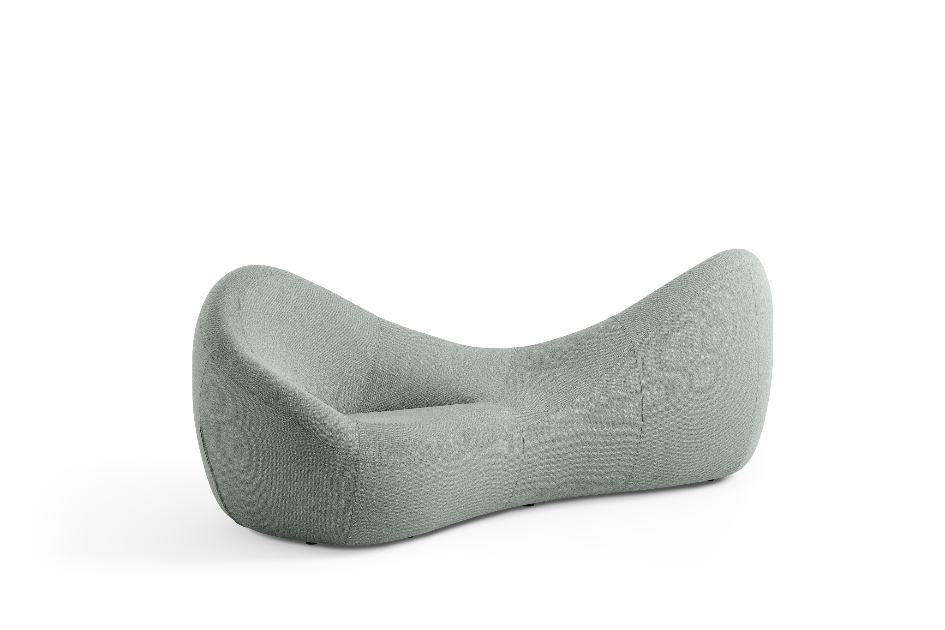
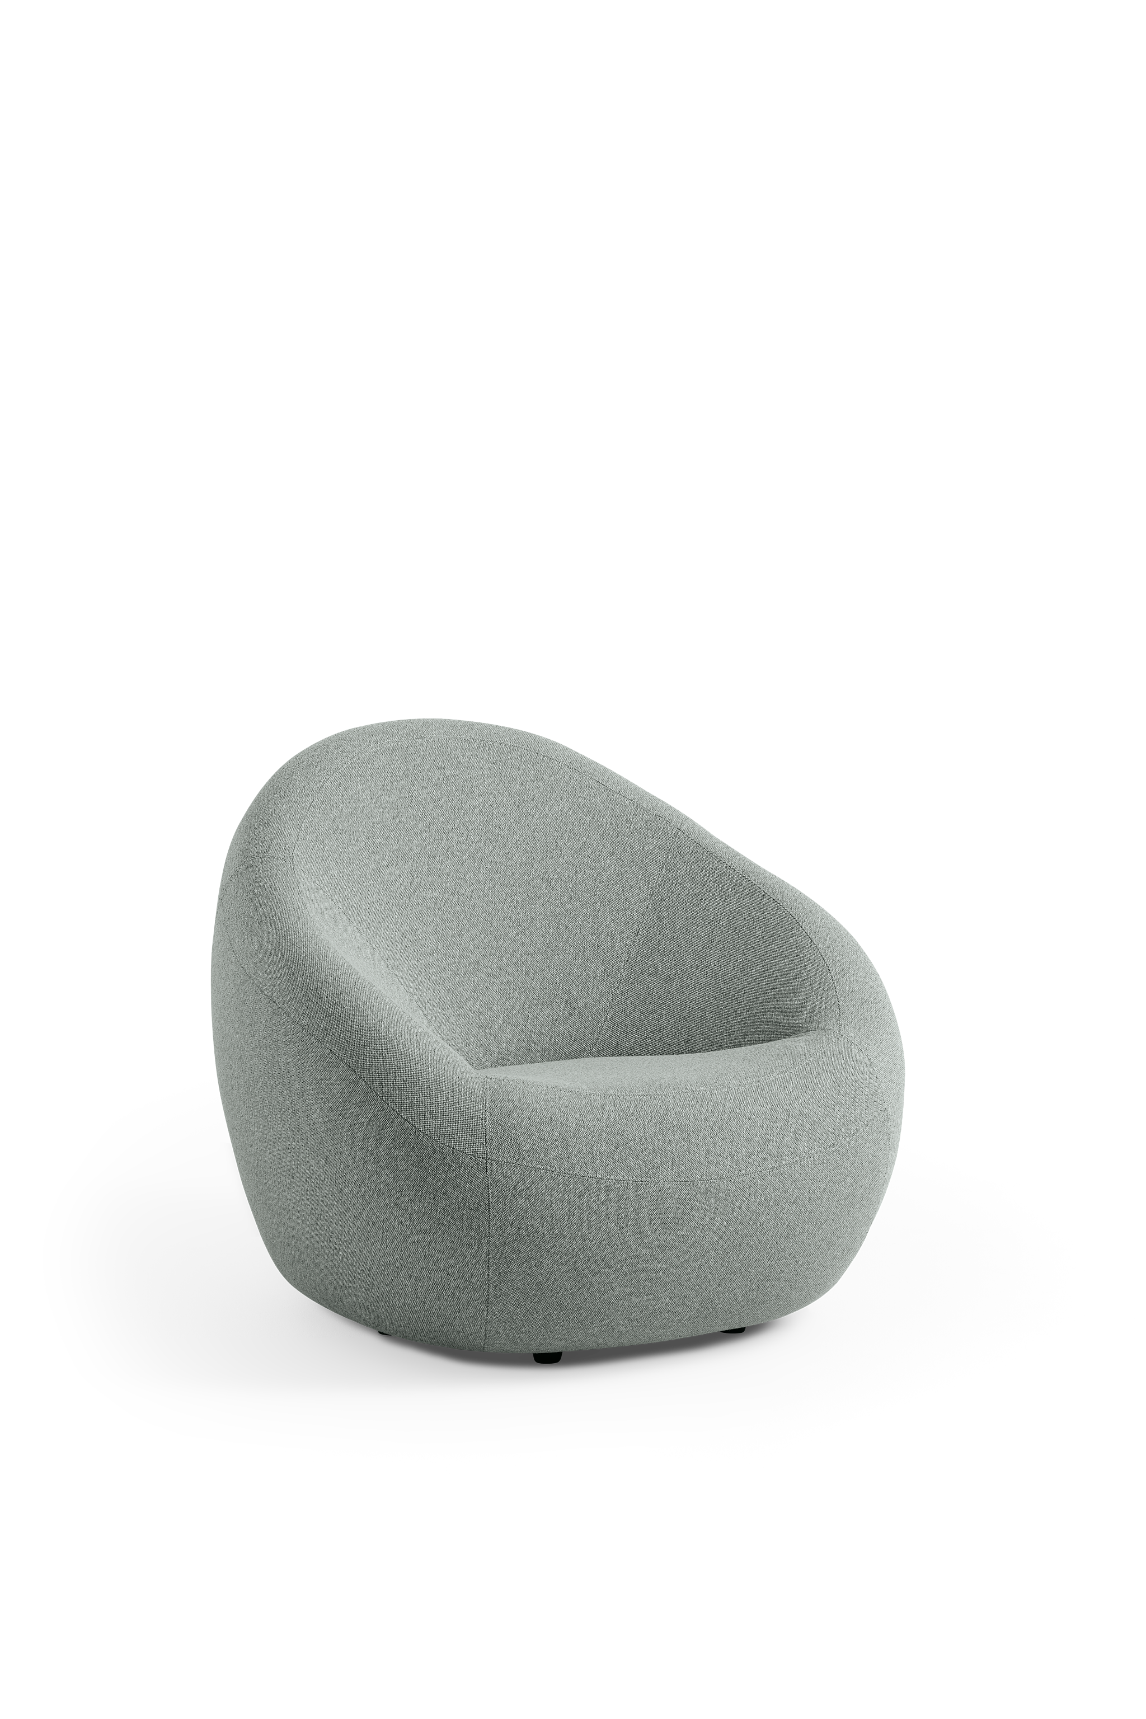
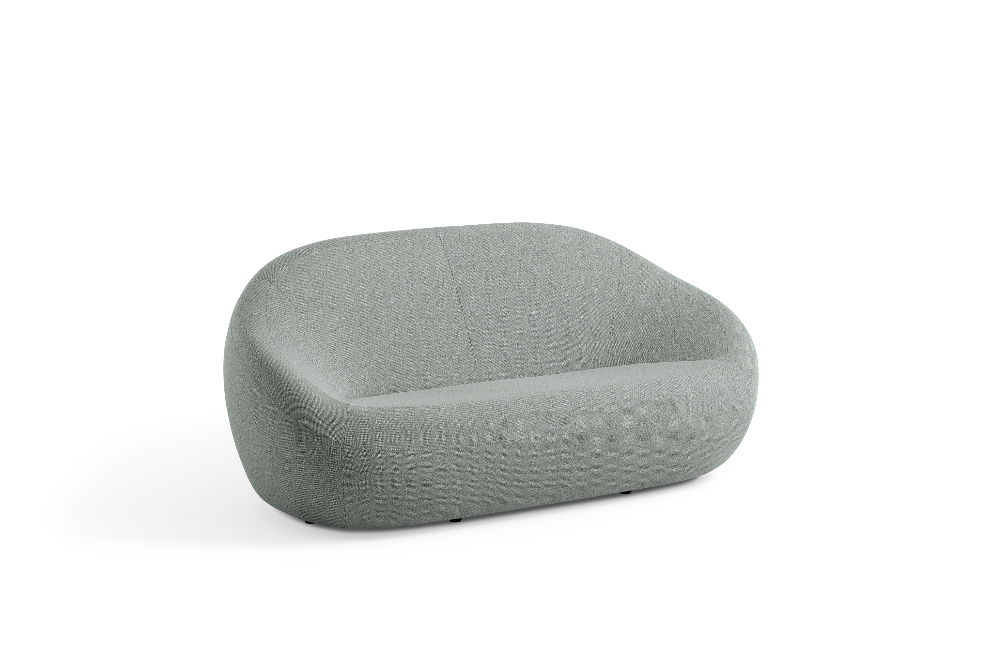
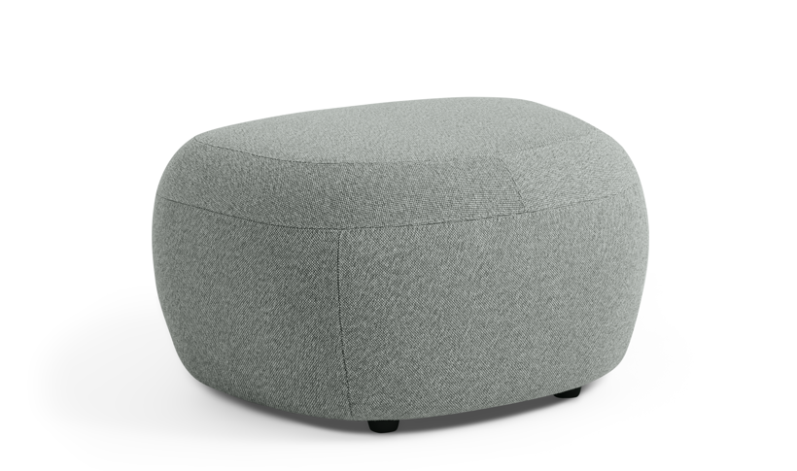
Statement of Line
Lounge
CONLCLC
36.63”D x 37.38”W x 32.63”H
Seat height: 15.75"
Ottoman
CONLCOT
21”D x 25”W x 14.5”H
Tete a Tete
CONLCTT
37.5”D x 88.63”W x 32.63”H
Seat height: 15.75"
Sofa
CONLCSF
37.5”D x 73.63”W x 32.75”H
Seat height: 15.75"

Slide 22
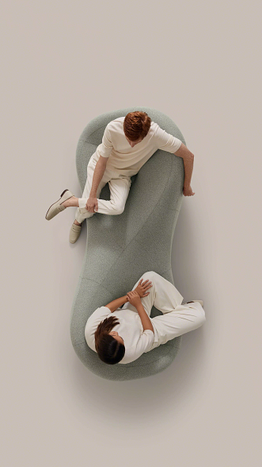
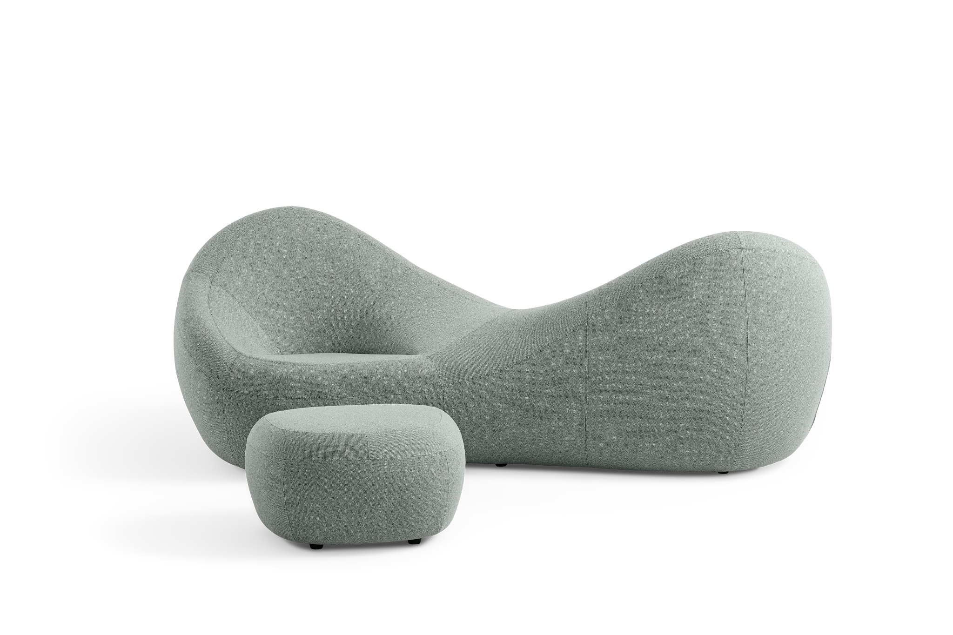
Jean Nouvel
Tête-à-Tête
The Tête-à-Tête allows two users to comfortably orient toward or away from their companion.
The Tête-à-Tête is available with black plastic glides.
Translated as “head-to-head”, the tête-à-tête lounge was traditionally a Victorian-era courting bench… a “gossip’s chair”. This conversation lounge gives you space to sit towards or away from others yet maintain closeness.

Slide 23
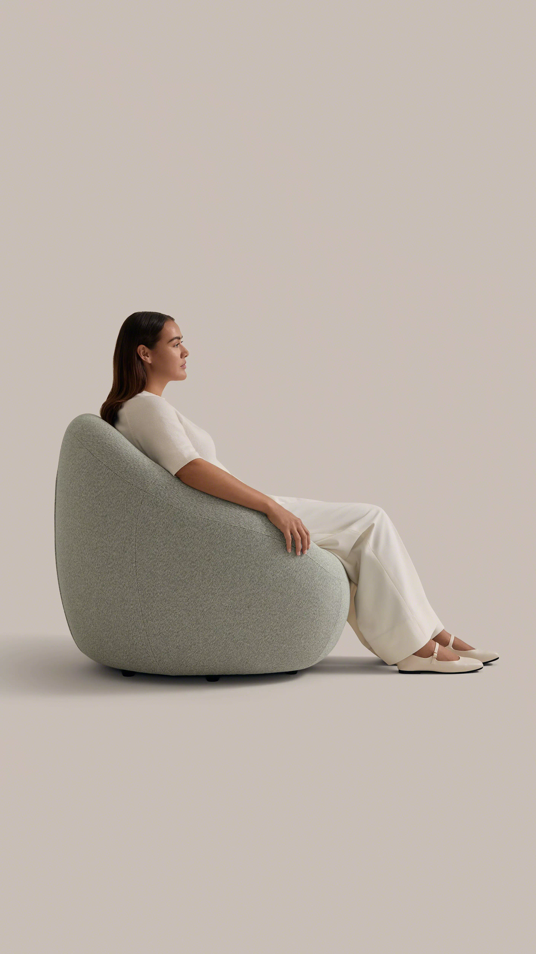
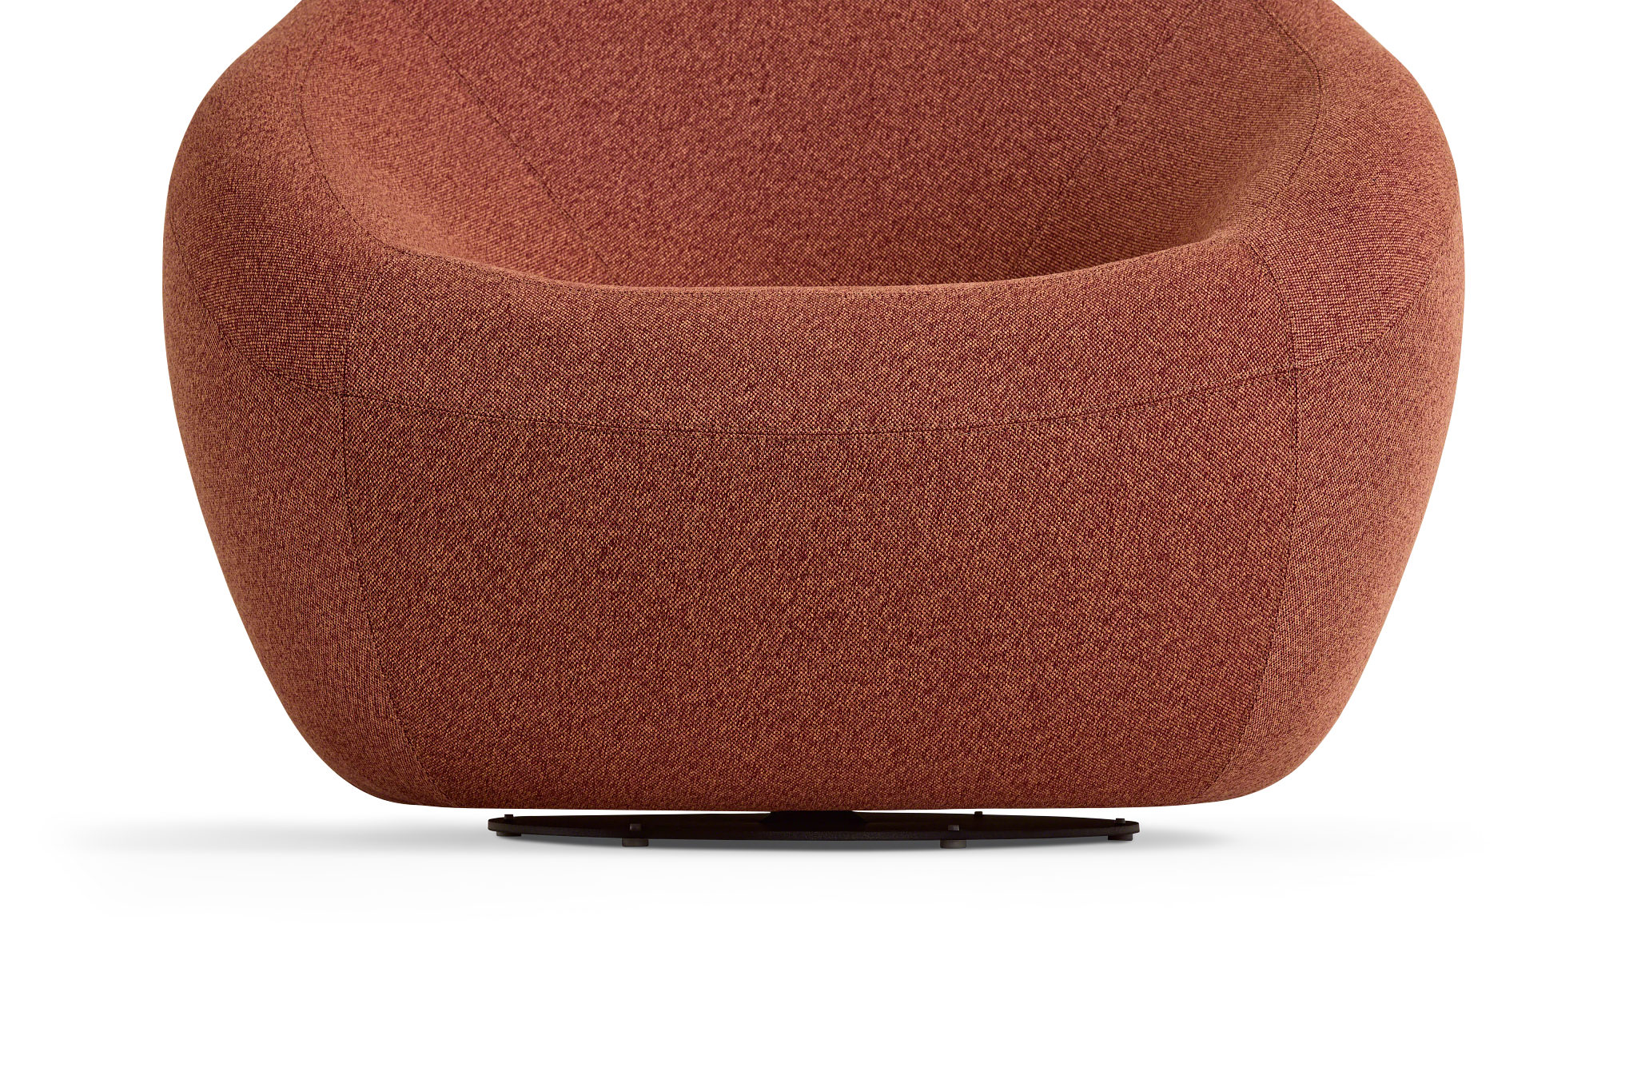
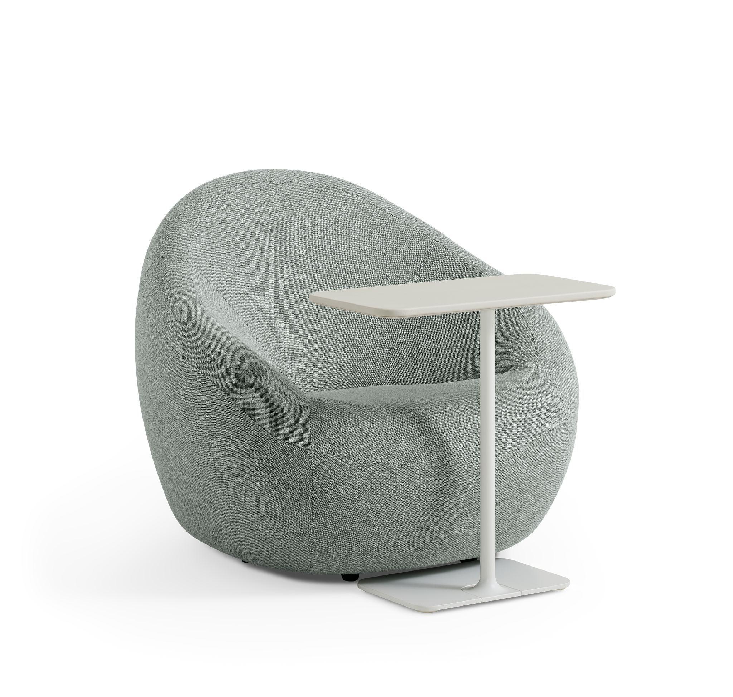
Jean Nouvel Lounge Chair
Far from formless, all pieces are engineered to support your arms and back.
Available with glides or a return to center base (pictured).
Each lounge invites you to relax into an organic form that feels like an extension of the body.
Pairs well with Lagunitas personal table.

Slide 24
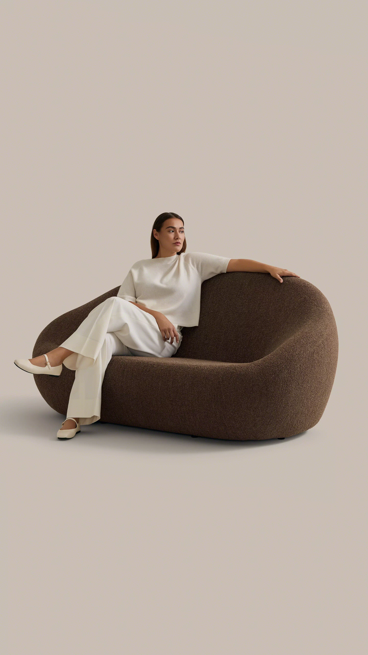
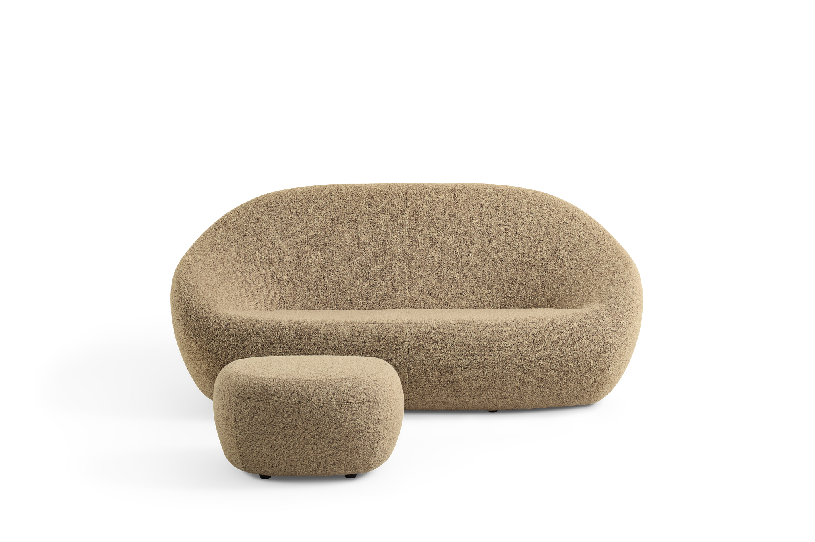
Jean Nouvel
Sofa
Generous width comfortably sits two people.
The Sofa is available with black plastic glides.
Fully rounded forms require extra artistry and skill to upholster around edgeless corners. We bring you the best fabrication so that fabric and stitching flow like a wave.

Slide 25
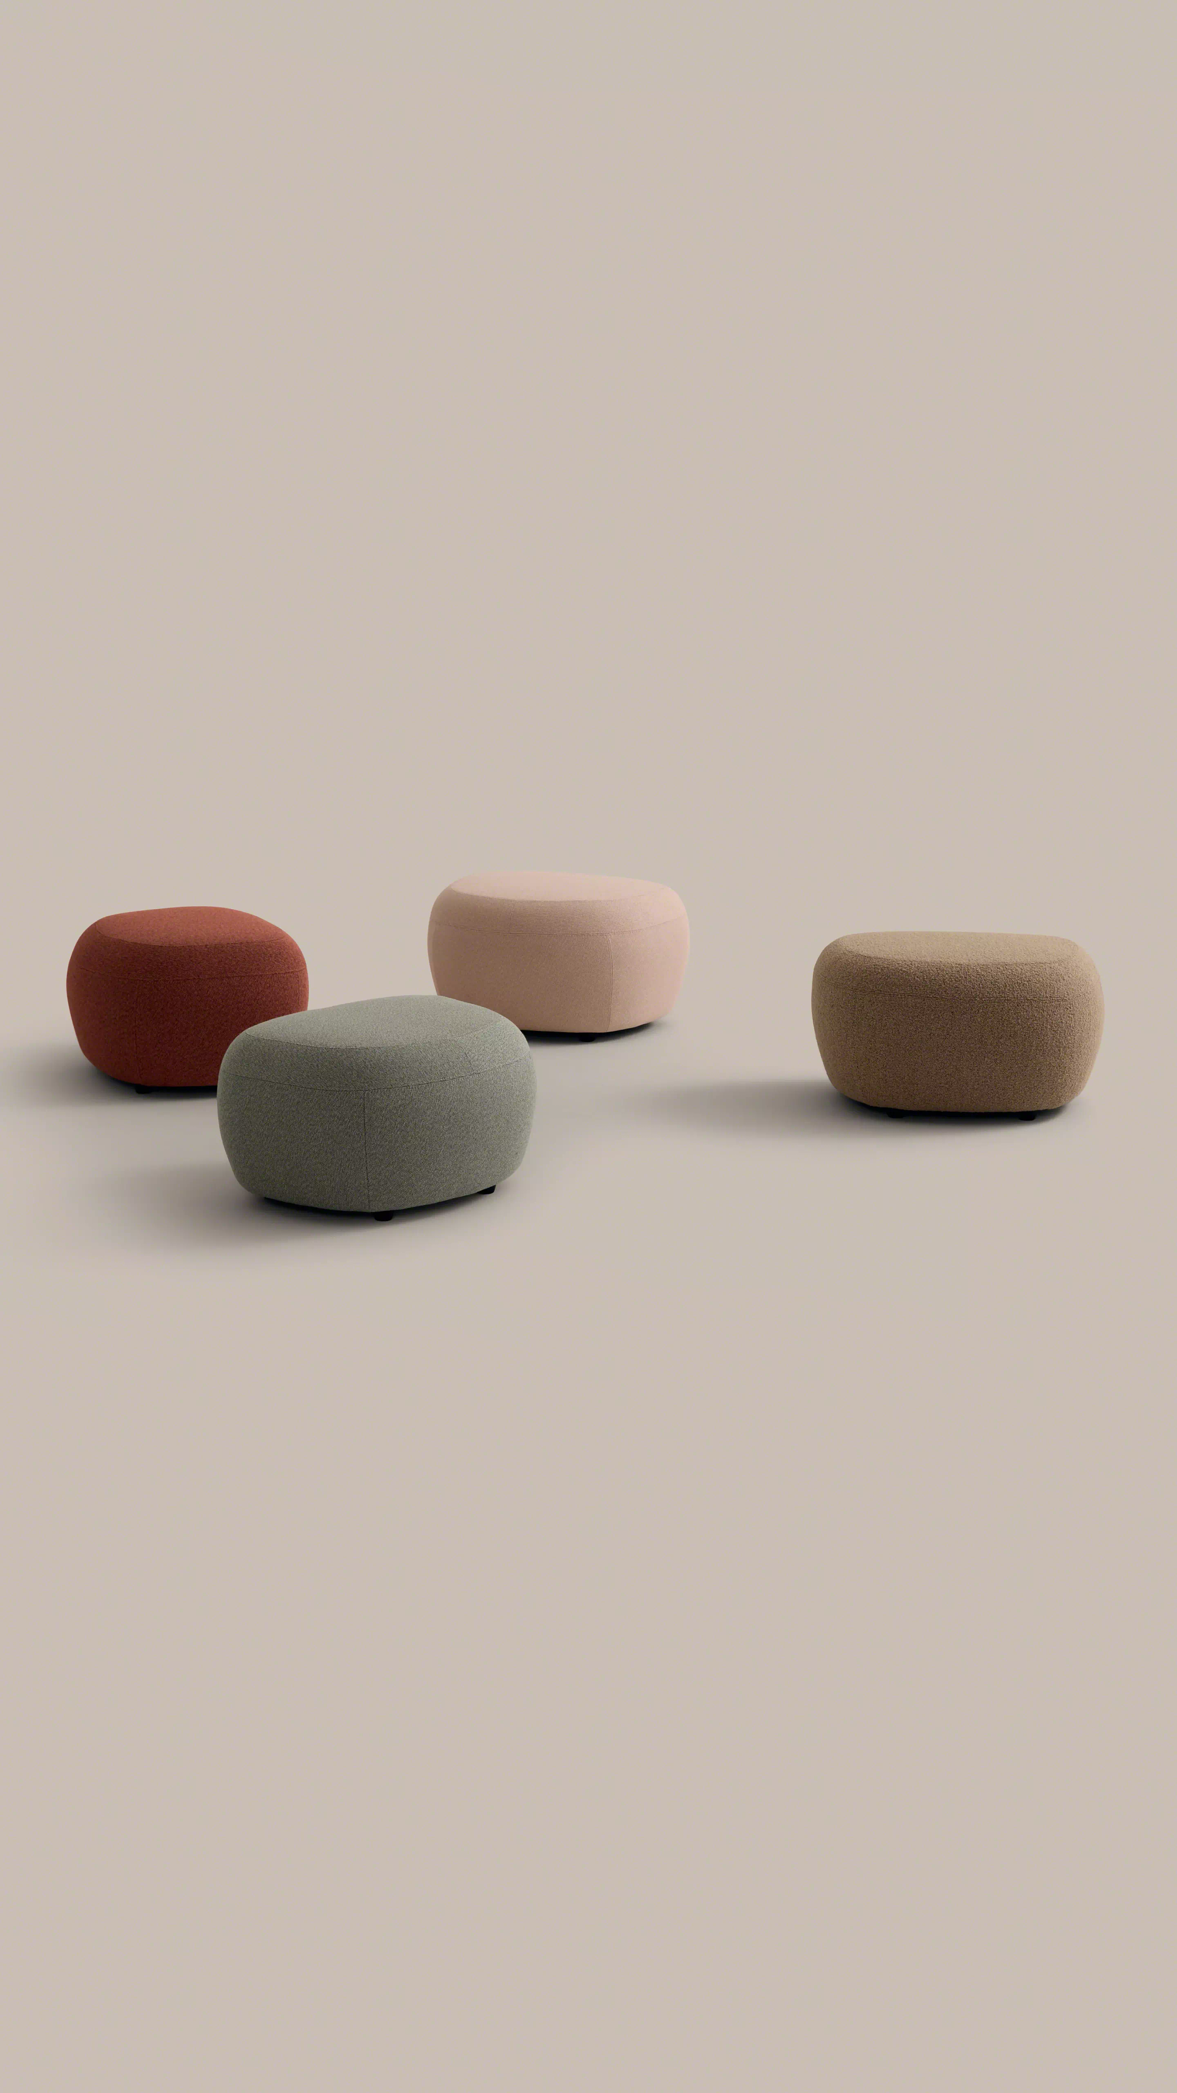
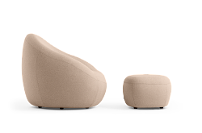
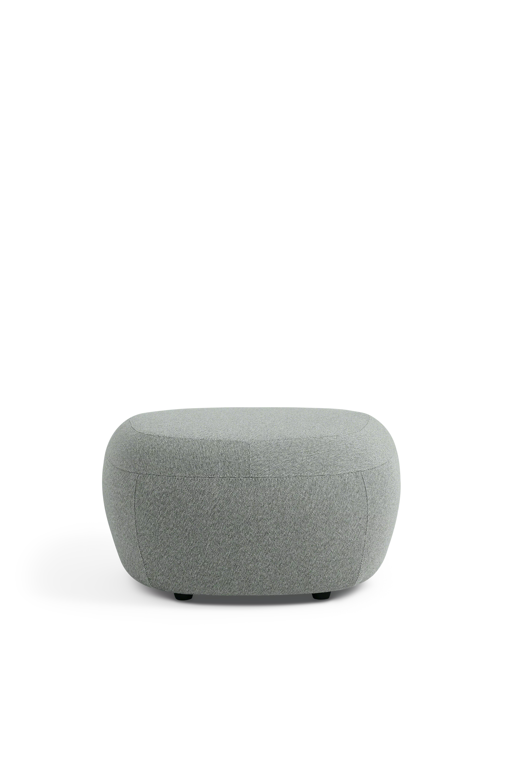
Jean Nouvel Ottoman
Designed to work well with all three Jean Nouvel seating products, the ottoman provides additional support in lounge posture.
Ottomans can be paired with any of the pieces from the collection, or function as a pouf for sitting.
Ottoman is available with black plastic glides.

Slide 26


